Slide 1
Neural Lyapunov Differentiable Predictive Control
Sayak Mukherjee, Jan Drgona, Aaron Tuor,
Mahantesh Halappanavar, Draguna Vrabie
jan.drgona@pnnl.gov
IEEE Conference on Decision and Control 2022

Slide 2
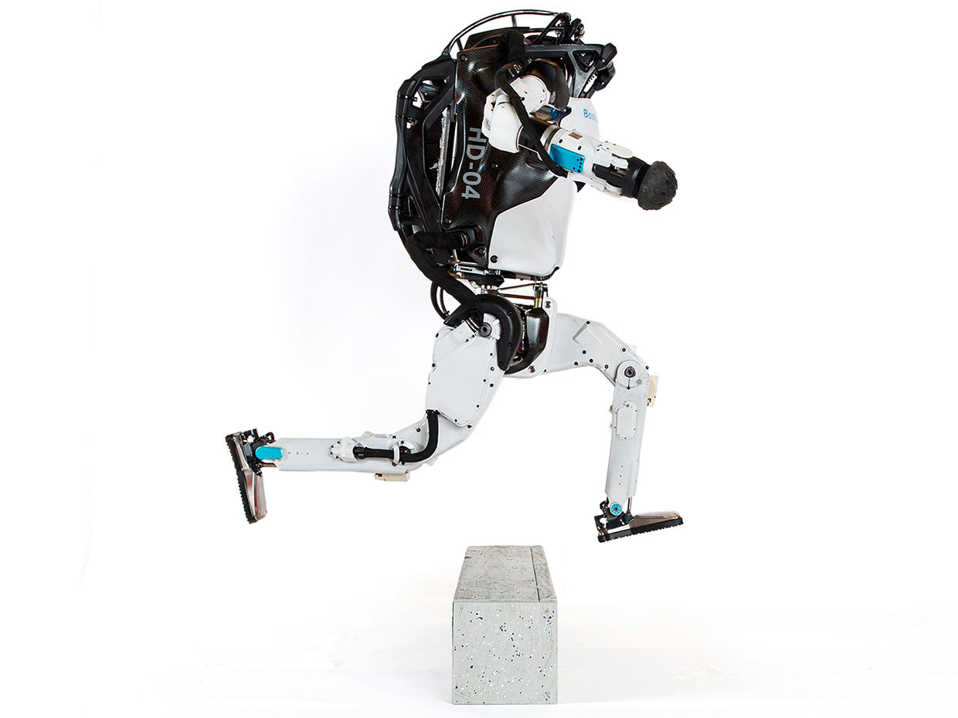


Model Predictive Control (MPC)
Successes
Challenges
95% of the industrial control applications are PID loops & expert driven rule-based control (RBC).
The rest is model predictive control (MPC).
Modeling
Unknown or partially known dynamics
Physics-based modeling is expensive
Purely data-driven models lack generalization
Real-time optimization
Scalability
Computational limitations of control hardware
Parallelization, distributed optimization
Assumption:
Reliable and accurate system dynamics model
Drgona J., J. Arroyo, I.C. Figueroa, D. Blum, K. Arendt, D. Kim, and E.P. Olle, J. Oravec, M. Wetter, D. L. Vrabie, L. Helsen. 2020. "All You Need to Know About Model Predictive Control for Buildings." Annual Reviews in Control, September 29, 2020
2

Slide 3
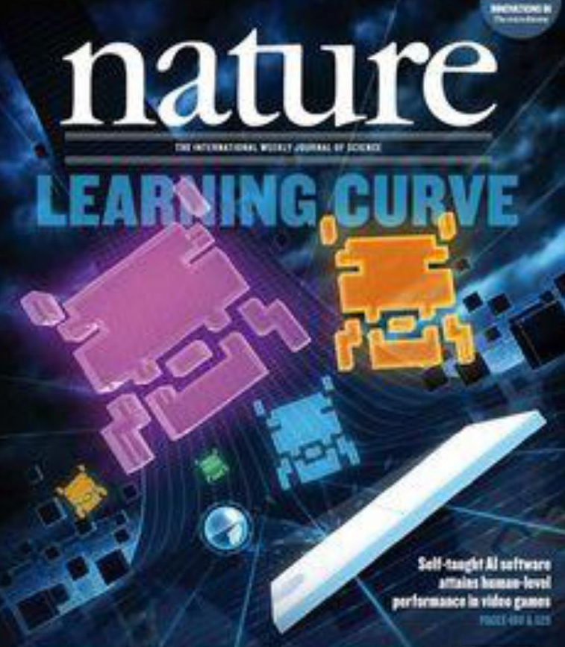
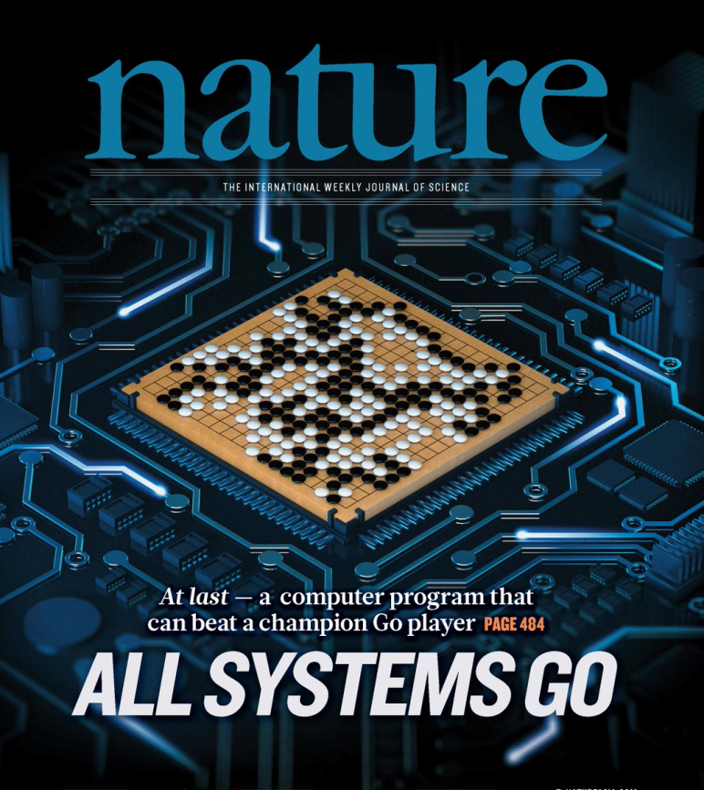
Deep Reinforcement Learning (DRL)
Challenges
Successes
Dealing with constraints, and stability guarantees. Learning on real system with low data and low compute regimes. Offline learning. High-dimensional continuous state and action systems. Partial observability, time delays. Task generalization and intrinsic rewards.
Everywhere where you have reliable simulation model, mostly discrete action space, and you can use massive offline compute power to solve the problem.
G. Dulac-Arnold, D. J. Mankowitz, and T. Hester, “Challenges of real-world reinforcement learning,”, 2019.
http://arxiv.org/abs/1904.12901

Slide 4

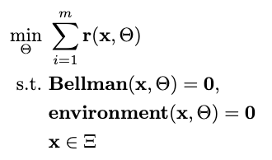

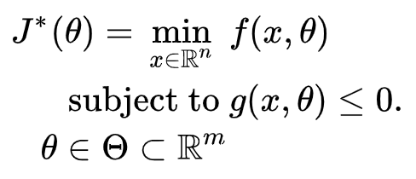

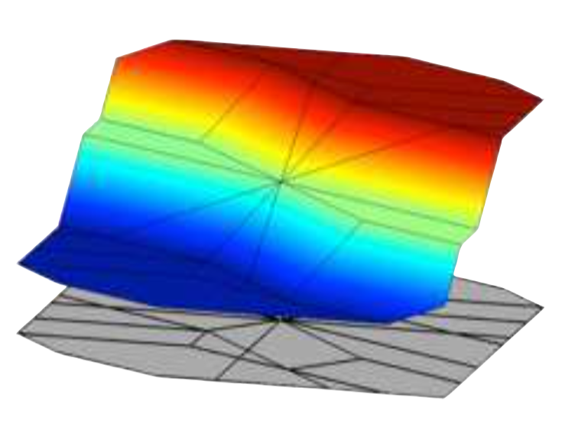
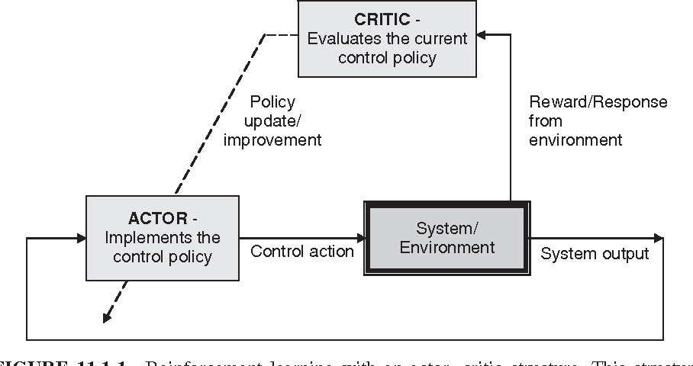

Optimization Methods for Control
Online MPC
Explicit MPC
Imitation Learning
Reinforcement Learning
“online” optimization
single solution for
given parameter values
implicit policy
“offline” optimization obtains a solution map
for a set of parameters
classical methods lead to exponential complexity!
“offline” optimization
obtains a model (map)
for a set of data points
scalable but requires expert controller
“offline” optimization
obtains a policy map
for a set of data points
poor convergence and
can’t handle constraints

Slide 5
Optimization Methods for Control
Online MPC
Explicit MPC
Imitation Learning
Reinforcement Learning
“online” optimization
single solution for
given parameter values
implicit policy
“offline” optimization obtains a solution map
for a set of parameters
classical methods lead to exponential complexity!
“offline” optimization
obtains a model (map)
for a set of data points
scalable but requires expert controller
“offline” optimization
obtains a policy map
for a set of data points
poor convergence and
can’t handle constraints
Today’s talk: differentiable programming and policy optimization for explicit MPC

Slide 6
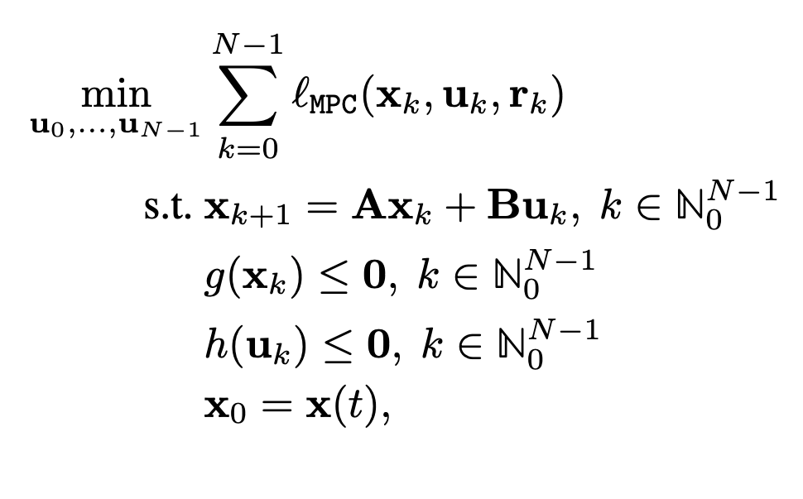
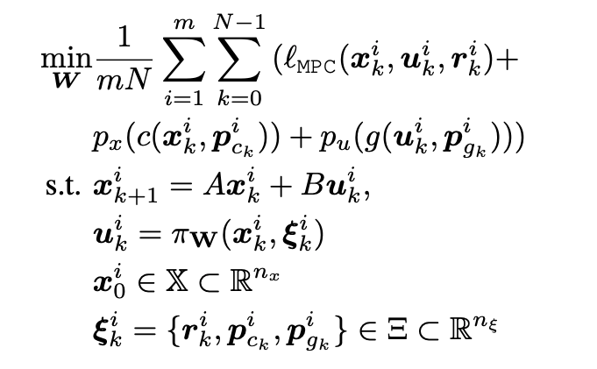
Differentiable Predictive Control (DPC)
From data to optimized explicit predictive control policy
MPC
DPC
Cost:
Model:
Constraints:
Online optimization
Optimize for control actions
Implicit solver-based control policy
Offline optimization
Optimize for control policy parameters
Explicit neural control policy
Jan Drgona, et al., Differentiable Predictive Control: An MPC Alternative for Unknown Nonlinear Systems using Constrained Deep Learning, Journal of Process Control, 2022

Slide 7
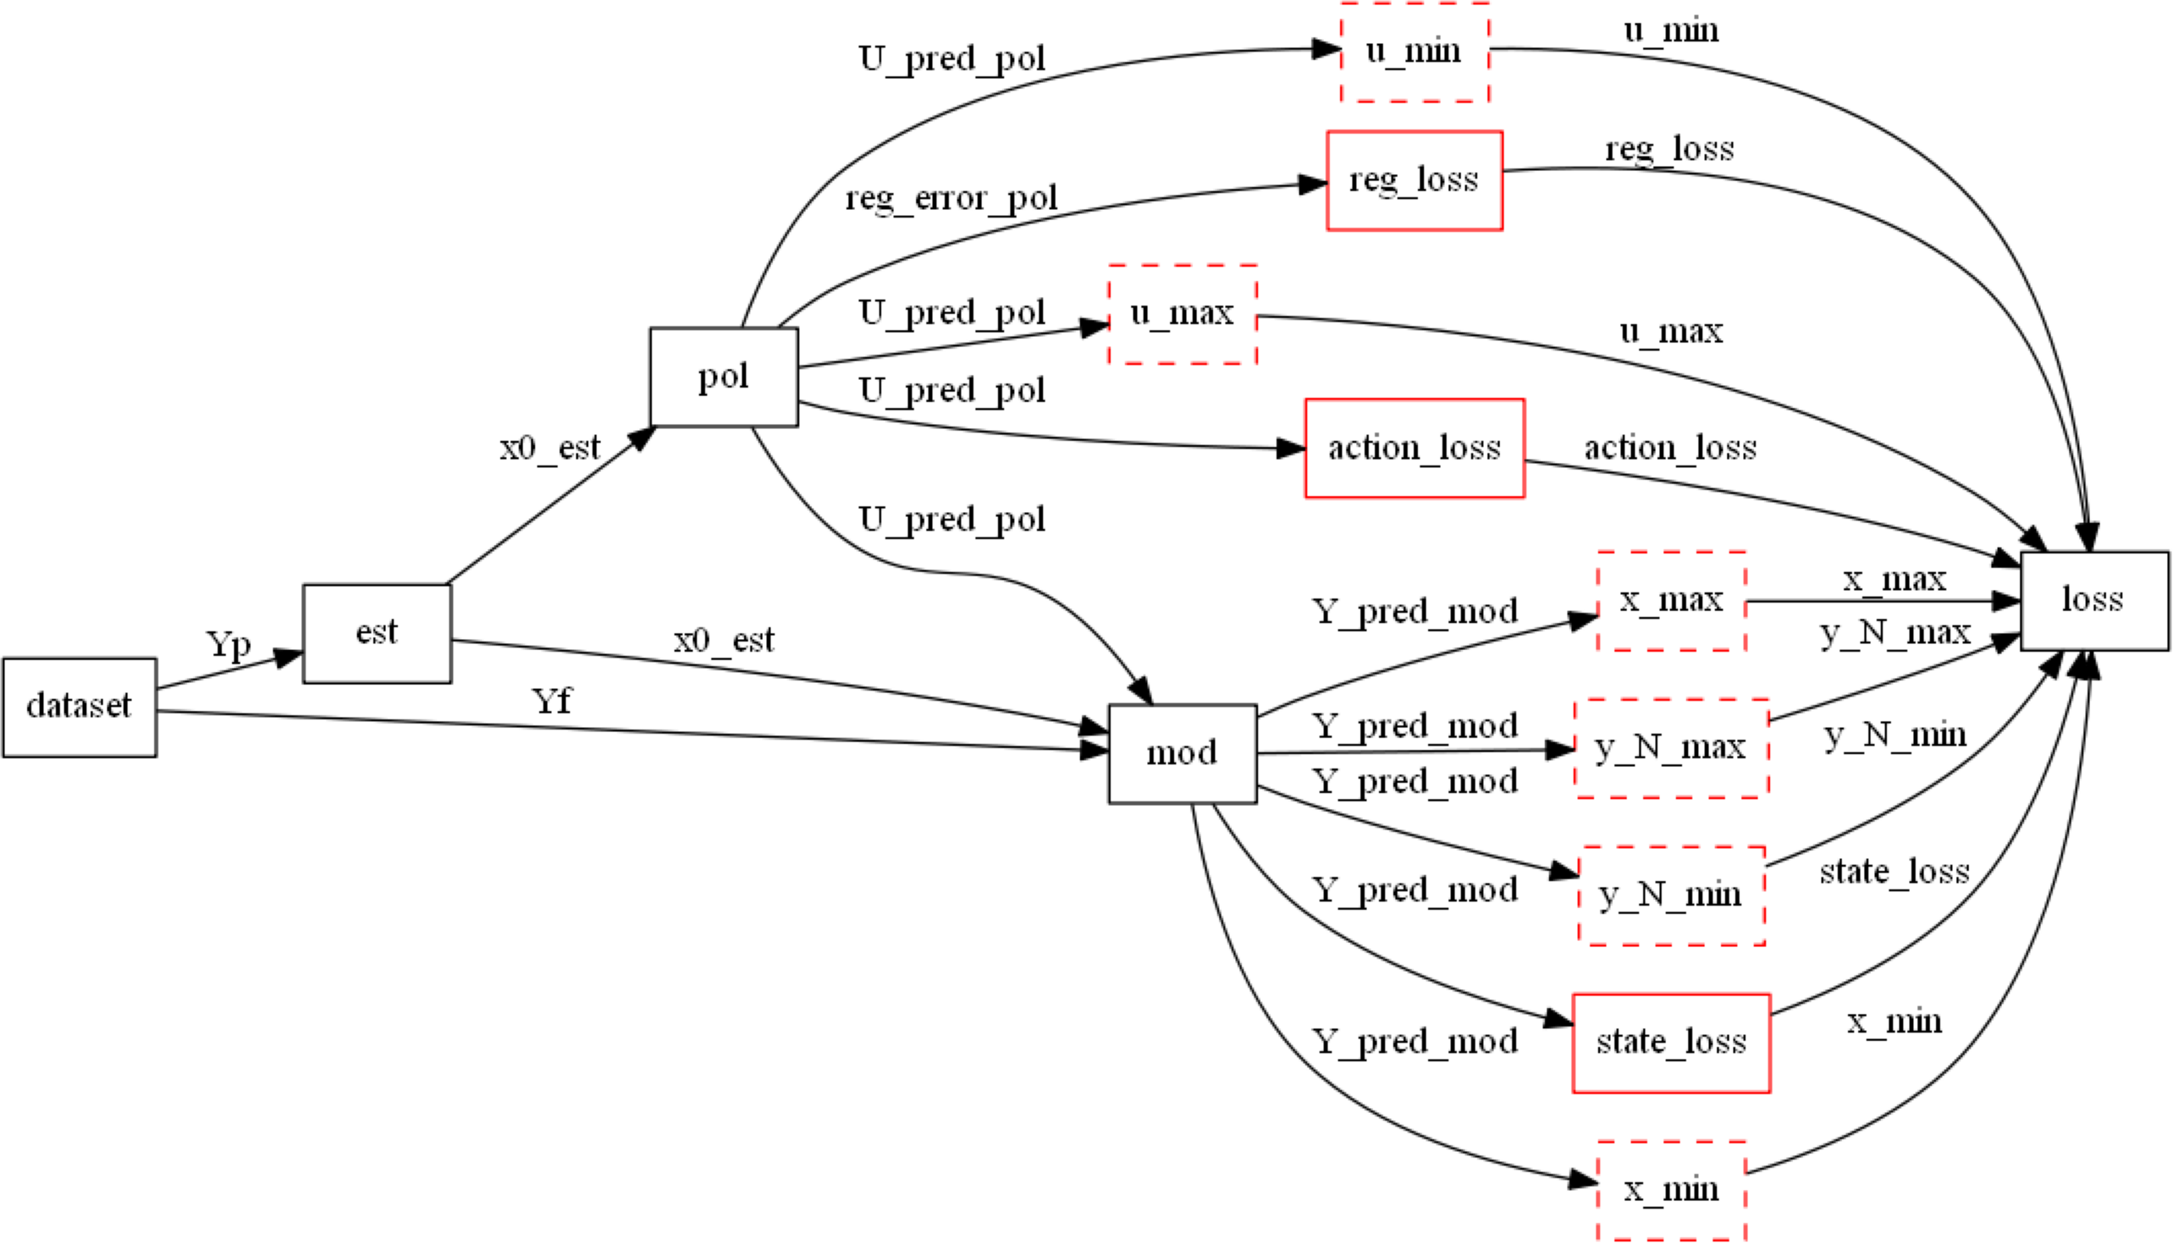
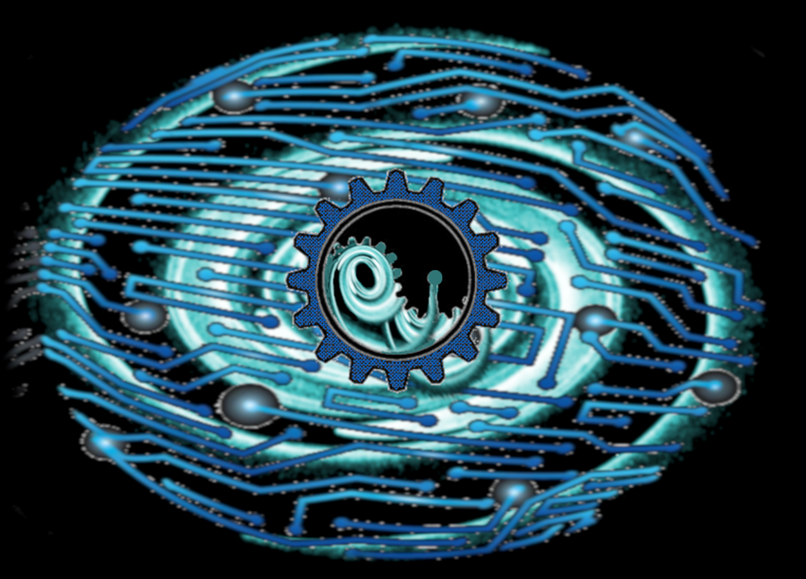

Differentiable Computational Graphs and Model-based Policy Gradients
Constructing differentiable computational graph: implementing parametric MPC problem in Pytorch.
https://pytorch.org/
https://github.com/pnnl/neuromancer

Slide 8
Differentiable Computational Graphs and Model-based Policy Gradients
Forward pass: evaluate graph components (policy, model, constraints, objective terms) to compute structured learning loss function.
https://github.com/pnnl/neuromancer

Slide 9
Differentiable Computational Graphs and Model-based Policy Gradients
Forward pass: evaluate graph components (policy, model, constraints, objective terms) to compute structured learning loss function.
https://github.com/pnnl/neuromancer

Slide 10
Differentiable Computational Graphs and Model-based Policy Gradients
Forward pass: evaluate graph components (policy, model, constraints, objective terms) to compute structured learning loss function.
https://github.com/pnnl/neuromancer

Slide 11
Differentiable Computational Graphs and Model-based Policy Gradients
Forward pass: evaluate graph components (policy, model, constraints, objective terms) to compute structured learning loss function.
https://github.com/pnnl/neuromancer

Slide 12
Differentiable Computational Graphs and Model-based Policy Gradients
Forward pass: evaluate graph components (policy, model, constraints, objective terms) to compute structured learning loss function.
https://github.com/pnnl/neuromancer

Slide 13
Differentiable Computational Graphs and Model-based Policy Gradients
Forward pass: evaluate graph components (policy, model, constraints, objective terms) to compute structured learning loss function.
https://github.com/pnnl/neuromancer

Slide 14
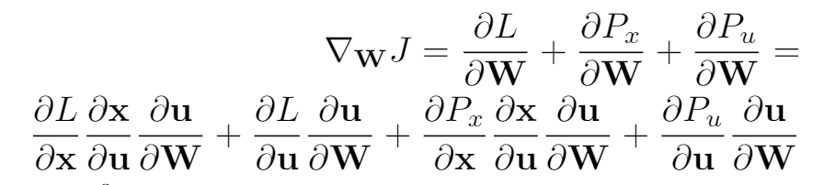
Differentiable Computational Graphs and Model-based Policy Gradients
Backward pass: Differentiate the computational graph to train the policies using state-of-the-art deep learning tools.
https://github.com/pnnl/neuromancer

Slide 15
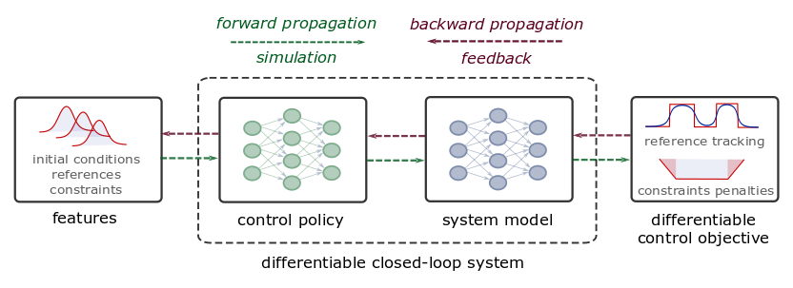
Differentiable Predictive Control (DPC) Recap
From data to explicit constrained control policy via differentiable optimization
Pros:
Cons:
Theoretical connection with MPC
Structured offline learning
Parametric solution of the MPC problem
Handling state and input constraints
Handling of arbitrary differentiable models
Lack of stability guarantees
Lack of constraints satisfaction guarantees
Lack of convergence guarantees
Can’t handle integer variables
Sampling-based
Notes:
The conceptual methodology of DPC is illustrated here.
Assuming time series dataset obtained from the measurements of the system dynamics, in the first step, we perform system identification using a neural state-space model (SSM).
In the second step, we close the loop by combining the neural SSM with neural control law obtaining a differentiable closed-loop dynamics model fully parametrized by neural networks.
This allows us to leverage standard tools in deep learning to optimize the neural control laws by backpropagating the MPC loss function through the closed-loop dynamics.
Essentially this is a data-driven solution to multiparametric programming problems emerging from explicit nonlinear MPC.
Contrary to approximate MPC (aka imitation learning), DPC does not require supervision by an expert controller. Instead, a dynamics model is learned from a small dataset of system measurements, and the control law is then optimized offline by differentiating the learned system model.

Slide 16
Differentiable Predictive Control (DPC) Recap
From data to explicit constrained control policy via differentiable optimization
Pros:
Cons:
Theoretical connection with MPC
Structured offline learning
Parametric solution of the MPC problem
Handling state and input constraints
Handling of arbitrary differentiable models
Lack of stability guarantees
Lack of constraints satisfaction guarantees
Lack of convergence guarantees
Can’t handle integer variables
Sampling-based
Notes:
The conceptual methodology of DPC is illustrated here.
Assuming time series dataset obtained from the measurements of the system dynamics, in the first step, we perform system identification using a neural state-space model (SSM).
In the second step, we close the loop by combining the neural SSM with neural control law obtaining a differentiable closed-loop dynamics model fully parametrized by neural networks.
This allows us to leverage standard tools in deep learning to optimize the neural control laws by backpropagating the MPC loss function through the closed-loop dynamics.
Essentially this is a data-driven solution to multiparametric programming problems emerging from explicit nonlinear MPC.
Contrary to approximate MPC (aka imitation learning), DPC does not require supervision by an expert controller. Instead, a dynamics model is learned from a small dataset of system measurements, and the control law is then optimized offline by differentiating the learned system model.

Slide 17
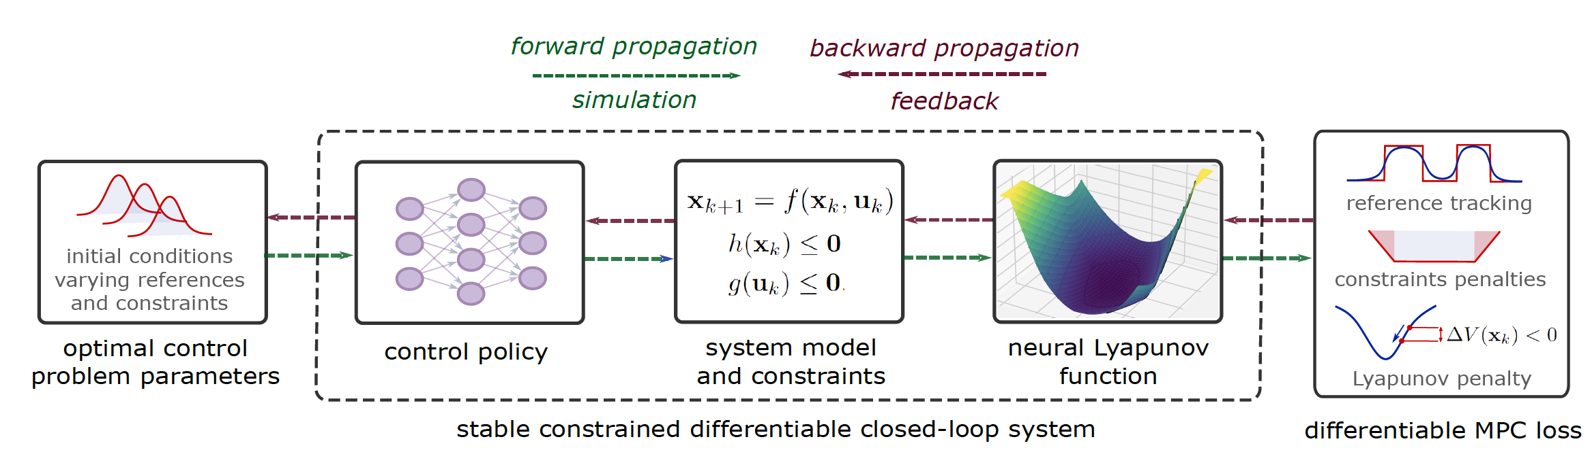
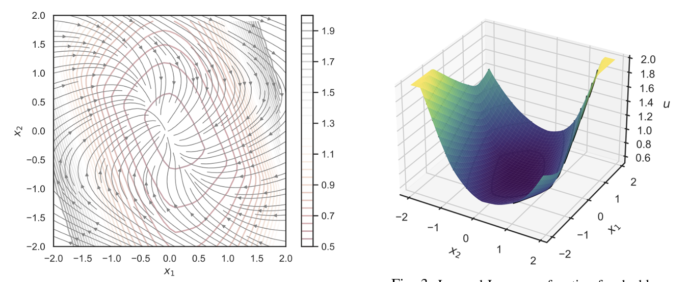
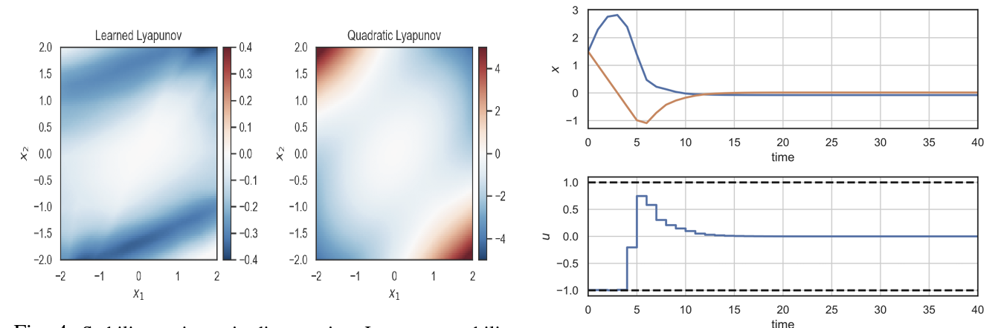
Joint DPC with Neural Lyapunov Functions
Sayak Mukherjee, Ján Drgoňa, Aaron Tuor, Mahantesh Halappanavar, Draguna Vrabie, Neural Lyapunov Differentiable Predictive Control, CDC, 2022
17

Slide 18
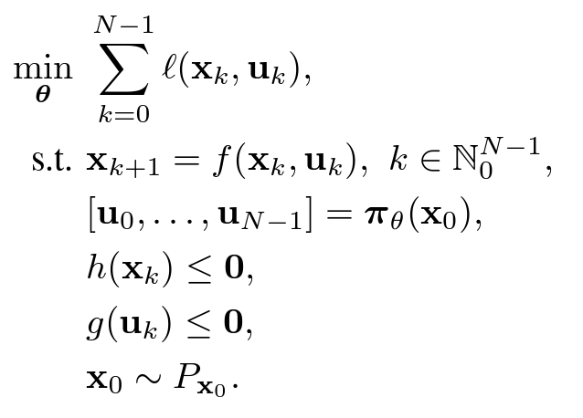
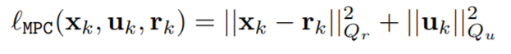
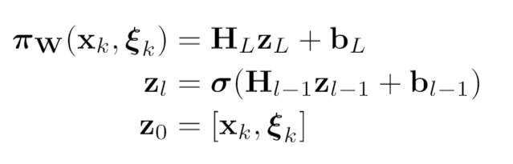
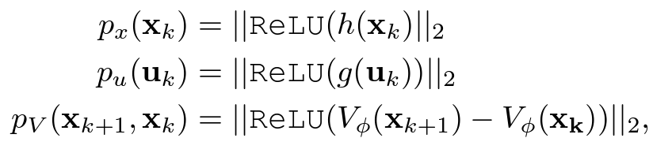
Mathematical framework
DPC Formulation with Neural Lyapunov Functions
Objective function
Dynamics
Lower-level
MPC objective function
Predictive policy
Constraints
Neural control policy
Soft state, and control constraints

Slide 19
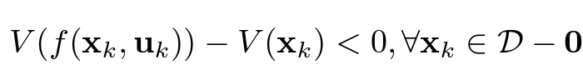
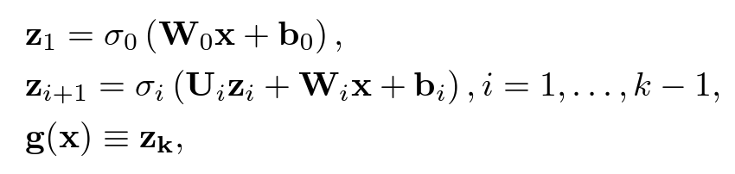
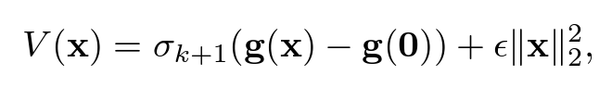
Mathematical framework
DPC Formulation with Neural Lyapunov Functions
Objective function
Dynamics
Lower-level
MPC objective function
Predictive policy
Constraints
Neural control policy
Lyapunov condition:
Input Convex Neural networks (ICNN)
Soft state, control, and Lyapunov constraints
Gaurav Manek, J. Zico Kolter, Learning Stable Deep Dynamics Models, NeurIPS 2019

Slide 20
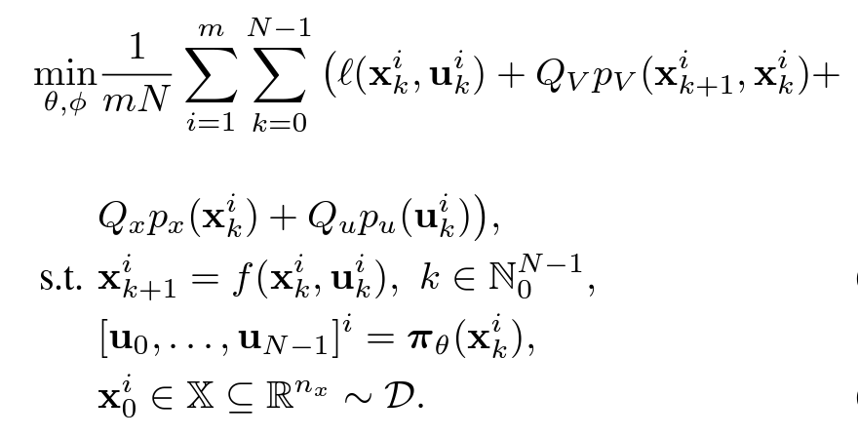
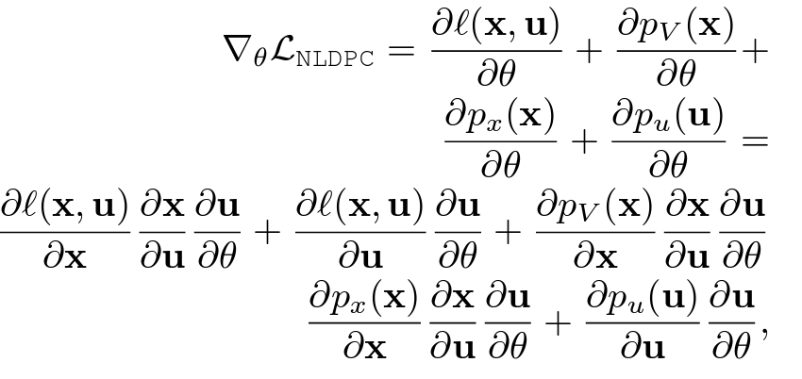
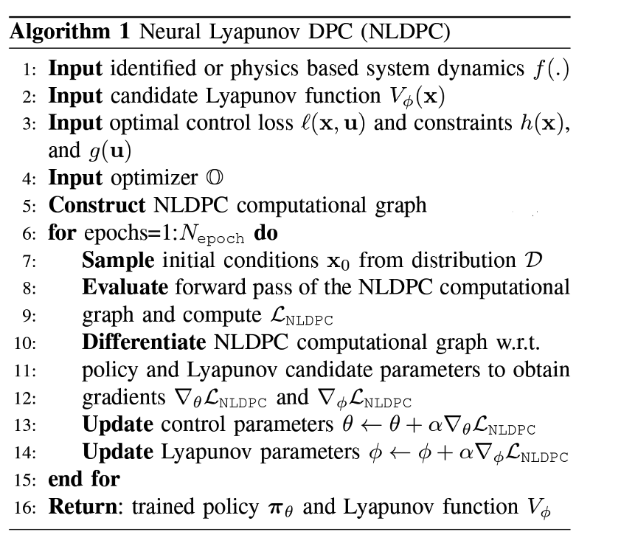
Mathematical framework and learning algorithm
Joint Offline Learning of Policy and Lyapunov Function
Learning Algorithm
NLDPC
Problem
Policy Gradients
Gradient flows:
For probabilistic stability guarantees see the paper Neural Lyapunov Differentiable Predictive Control.

Slide 21
Experiments: Stabilizing Unstable Double Integrator
Phase portrait with overlaid Lyapunov contours
Learned Lyapunov
function
Stability regions via discrete-time Lyapunov conditions
Closed-loop state and control trajectories

Slide 22
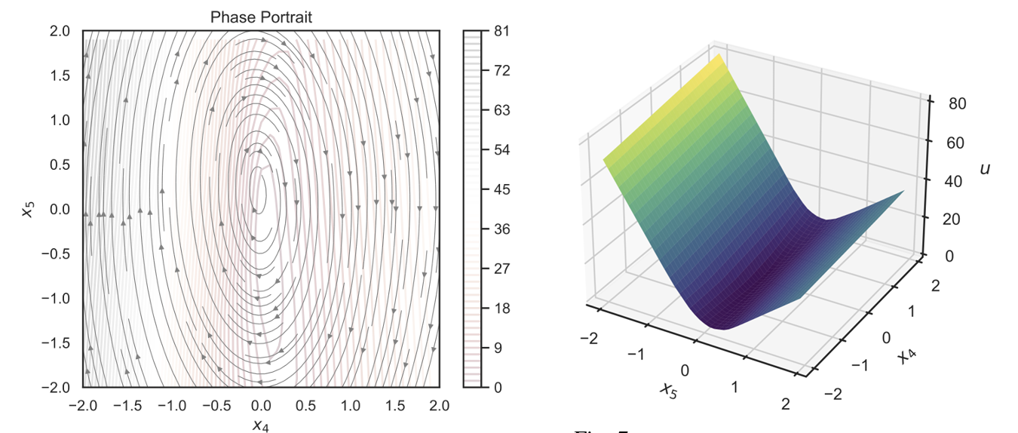
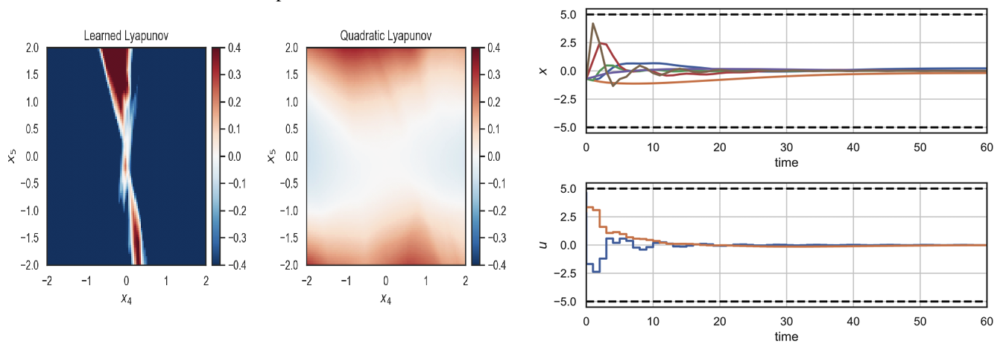
Experiments: Controlling Unstable PVTOL Aircraft
Phase portrait with overlaid Lyapunov contours
Slice of the learned Lyapunov
function
Stability regions via discrete-time Lyapunov conditions
Closed-loop state and control trajectories

Slide 23
Conclusion and Future Directions
Summary
Next steps
Learning explicit predictive control policies via differentiable predictive control (DPC) algorithm
Learning neural Lyapunov functions for probabilistic closed-loop stability guarantees
Open-source code
Online safety filters based on learned Lyapunov functions
Dealing with time-varying nonlinear objectives and constraints
Dealing with economic objectives via Dissipativity
https://github.com/pnnl/neuromancer/tree/Lyapunov_DPC
jan.drgona@pnnl.gov

Slide 24


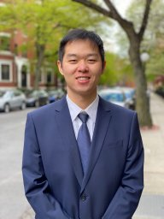

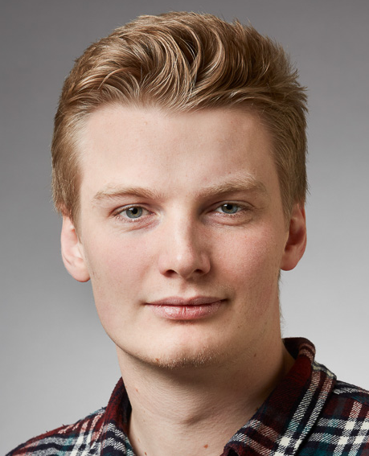



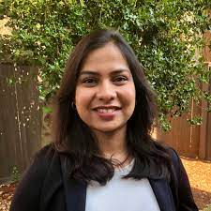





Acknowledgements
Aaron Tuor
James Koch
Zhao Chen
Stefan Dernbach
Christian M. Legaard
Ethan King
Sayak Mukherjee
Wenceslao Shaw Cortez
Soumya Vasisht
Shrirang Abhyankar
Mahantesh Halappanavar
Draguna Vrabie

Slide 25

Differentiable Predictive Control (DPC)
From data to optimized explicit control policy
Step 1: obtain system dynamics model or train the model using given time series data
Step 2: sample problem parameters and differentiate MPC computational graph to obtain gradients for training the policy offline
Jan Drgona, et al., Differentiable Predictive Control: An MPC Alternative for Unknown Nonlinear Systems using Constrained Deep Learning, Journal of Process Control, 2022

Slide 26
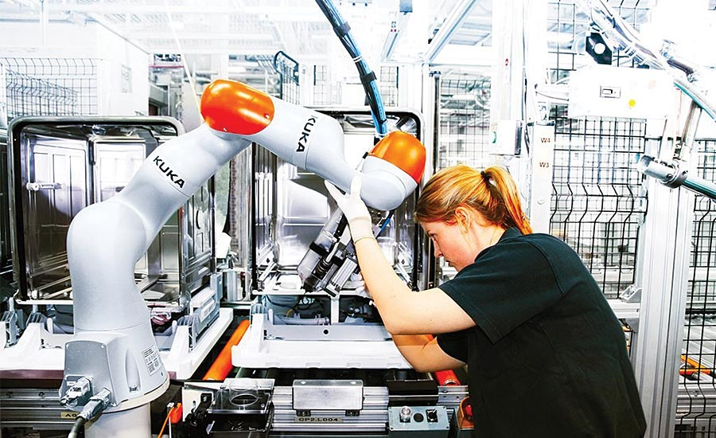
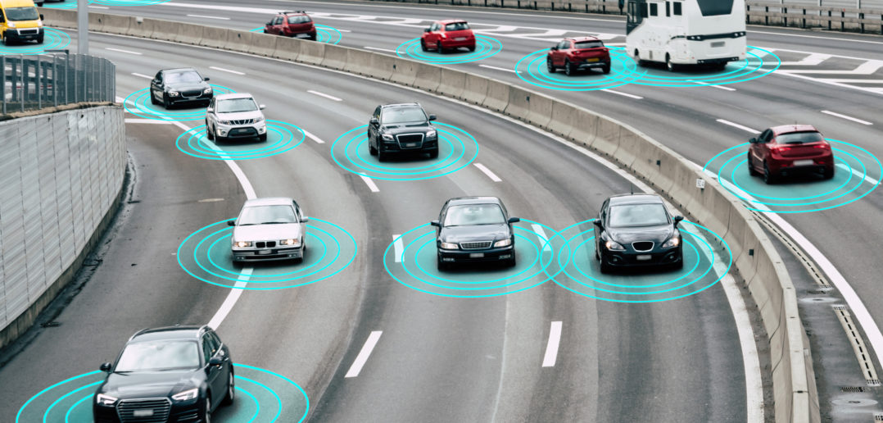
Motivation: Safety-Critical Control and Learning
Safety
Increased automation in human environments
Robots
Automated vehicles
Prevent system damage
Task specifications (not just stability)
Empirically shown to perform well
Implemented with low computational burden
Perforance highly dependent on:
Training set
Expert `behind-the-curtain’
Learning-based Control

Slide 27
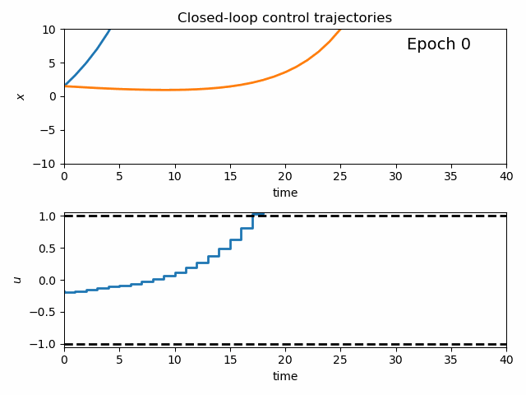
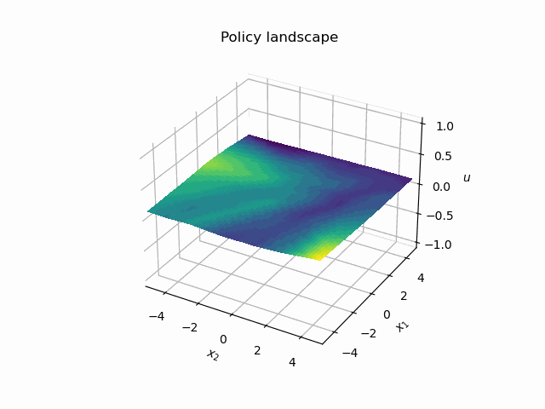
Dynamics of DPC Control Policy Learning
1341 learning parameters, 48.2 seconds offline training time on a CPU with 200 epochs.

